Slide 1
AVNRT project: recap of results
January 2025
Andrea Corrado

Slide 2
Outline
Problem statement: recap
Feature extraction
Envelope features
Template matching features
Short time Fourier transformation features
Classification
Feature correlation analysis
Knowledge based approach
Machine learning approach: tree – SVM - MLR
Best model evaluation
Conclusions
Appendix

Slide 3
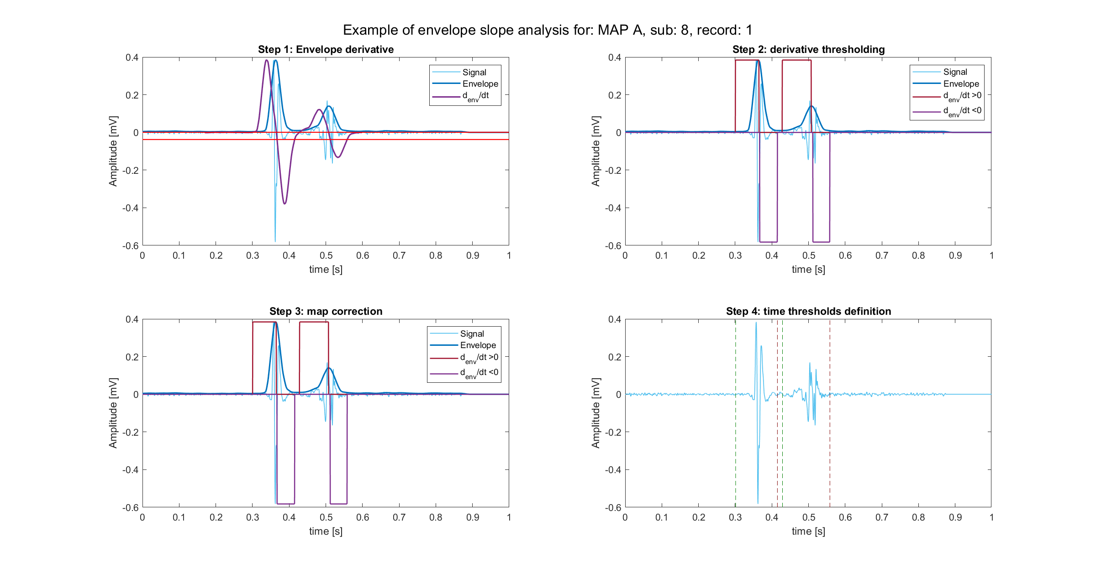
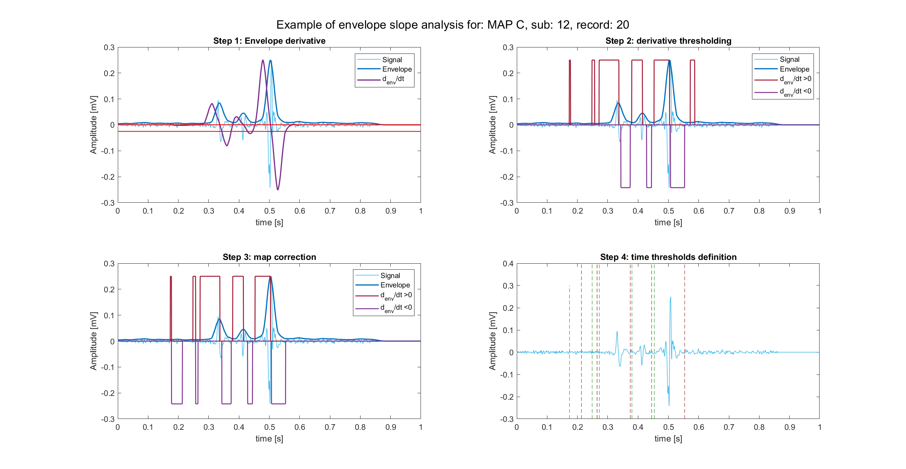
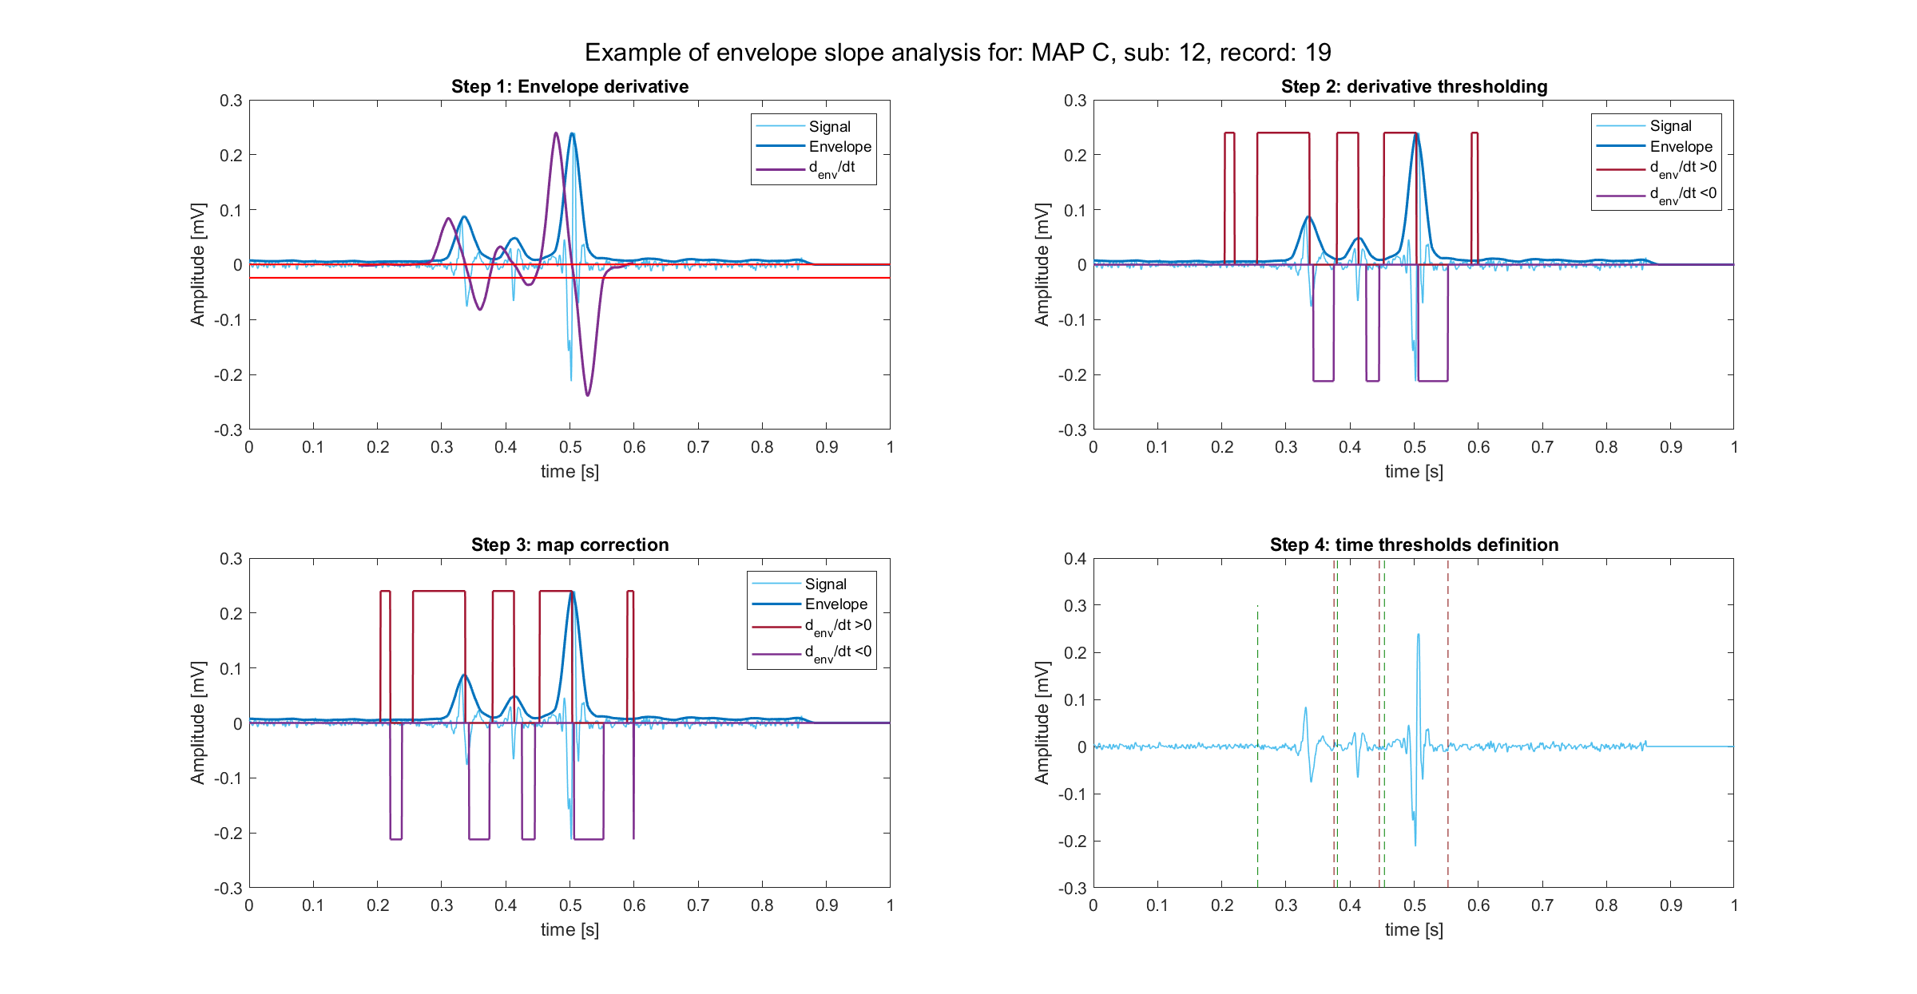
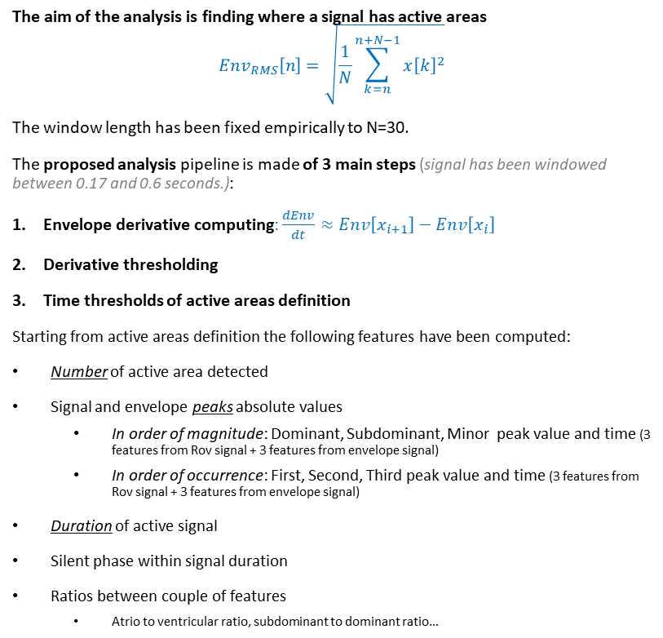
Envelope features definition
The aim of the analysis is finding where a signal has active areas
$$Env_{RMS}\left[n\right]=\sqrt{\frac{1}{N}\sum_{k=n}^{n+N−1}{x{\left[k\right]}^{2}}}$$
The window length has been fixed empirically to N=30.
The proposed analysis pipeline is made of 3 main steps (signal has been windowed between 0.17 and 0.6 seconds.):
Envelope derivative computing: $\frac{dEnv}{dt}≈Env\left[x_{i+1}\right]−Env\left[x_{i}\right]$
Derivative thresholding
Time thresholds of active areas definition
Starting from active areas definition the following features have been computed:
Number of active area detected
Signal and envelope peaks absolute values
In order of magnitude: Dominant, Subdominant, Minor peak value and time (3 features from Rov signal + 3 features from envelope signal)
In order of occurrence: First, Second, Third peak value and time (3 features from Rov signal + 3 features from envelope signal)
Duration of active signal
Silent phase within signal duration
Ratios between couple of features
Atrio to ventricular ratio, subdominant to dominant ratio…
1
2
3

Slide 4
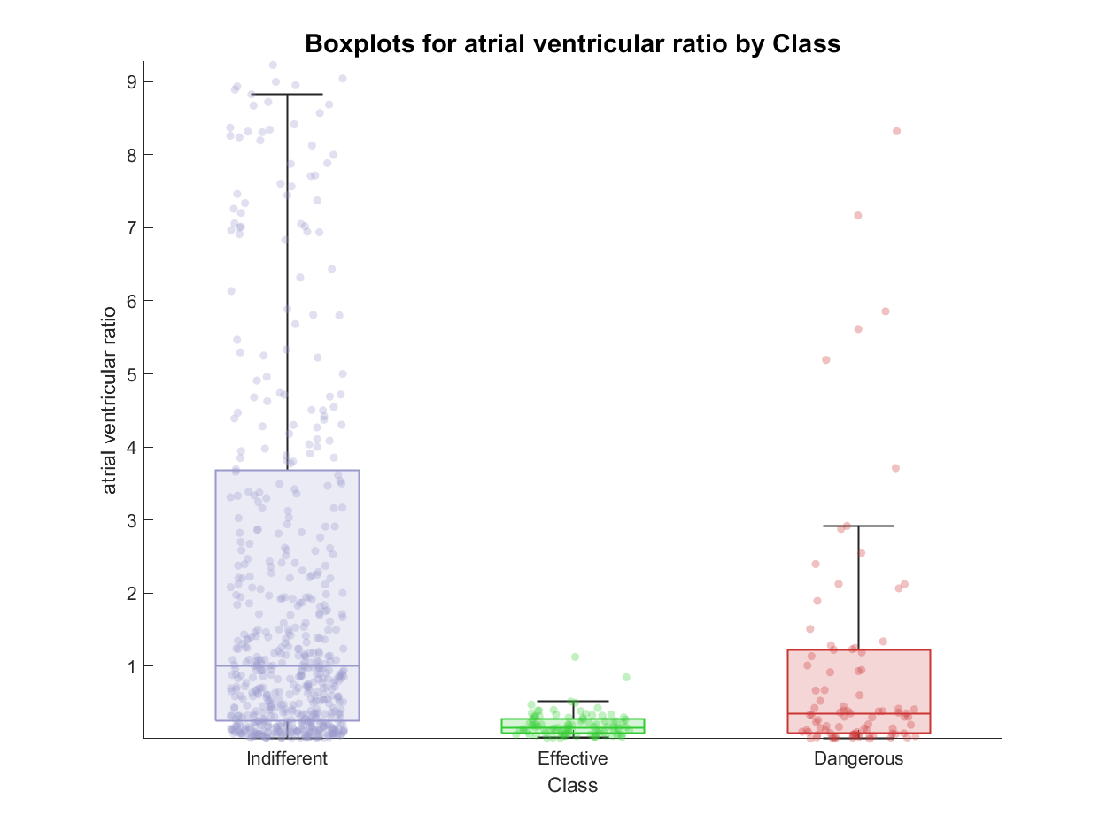
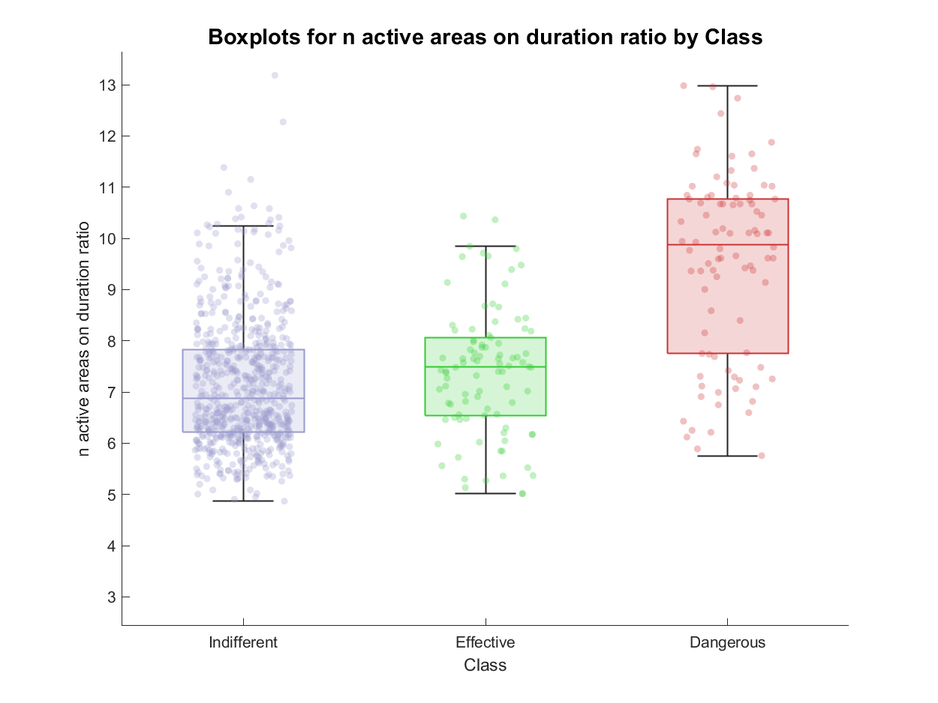
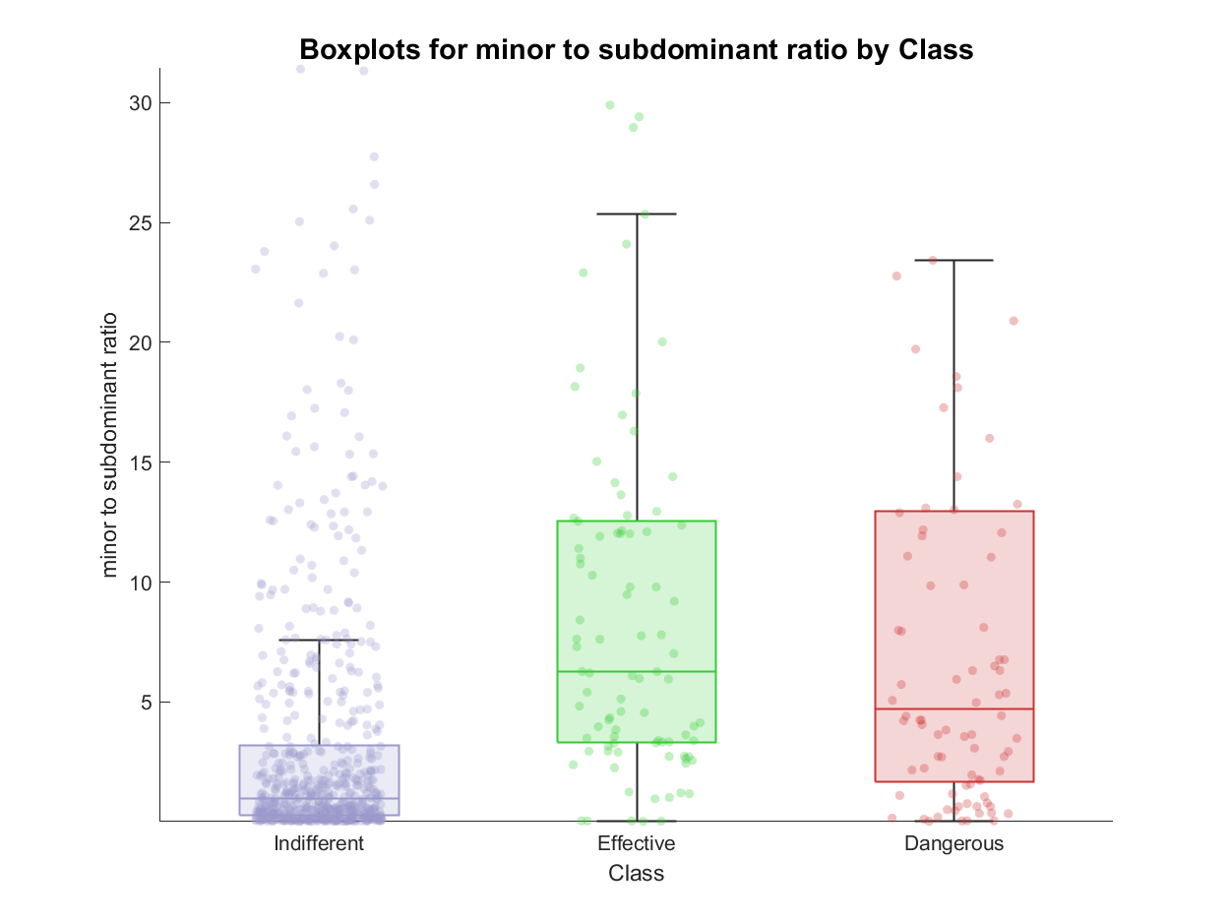
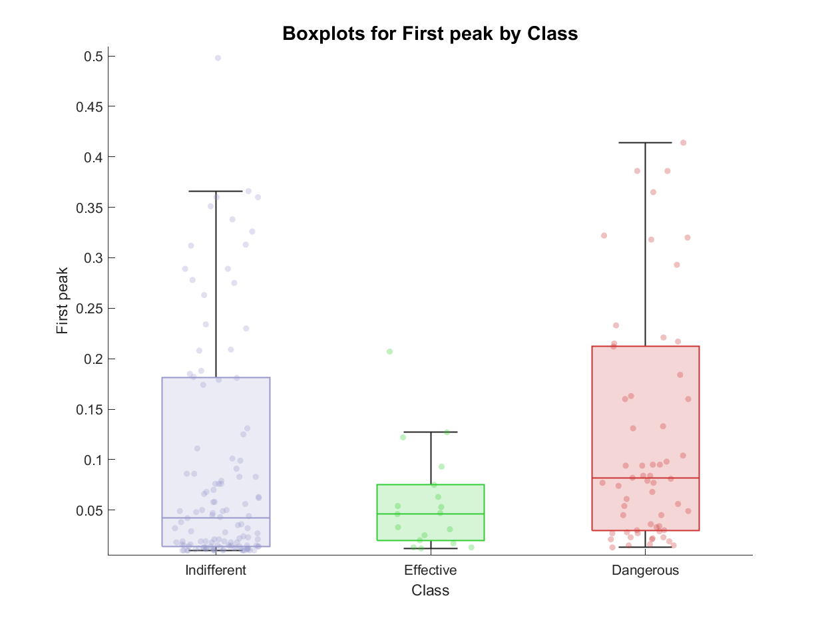
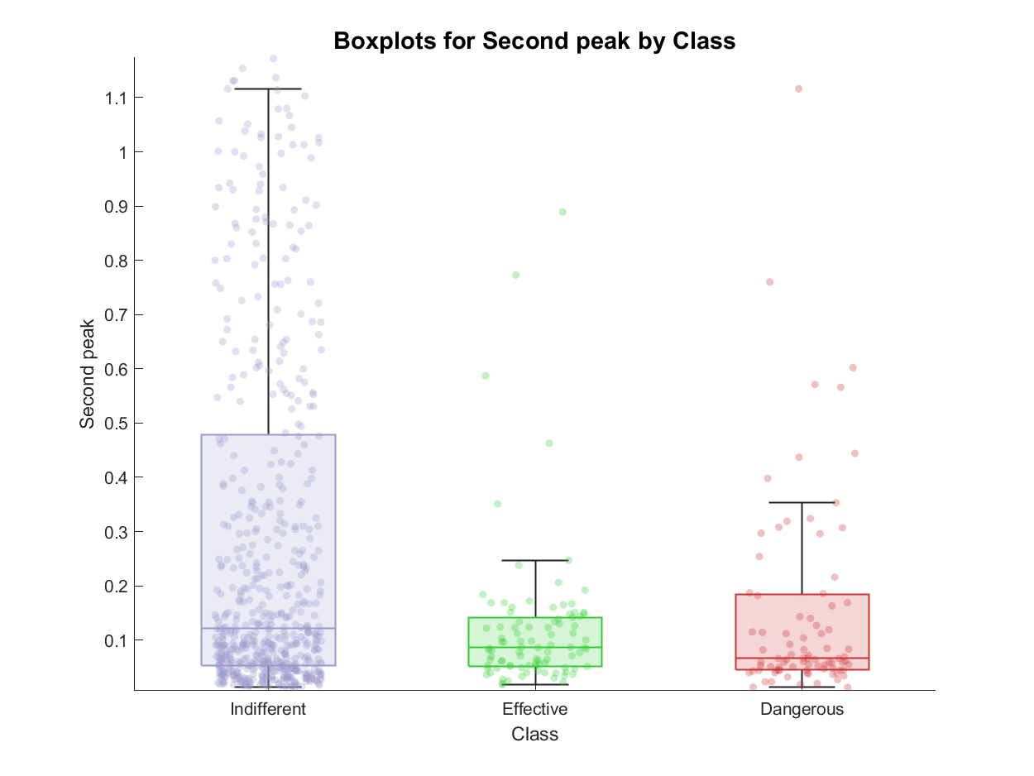
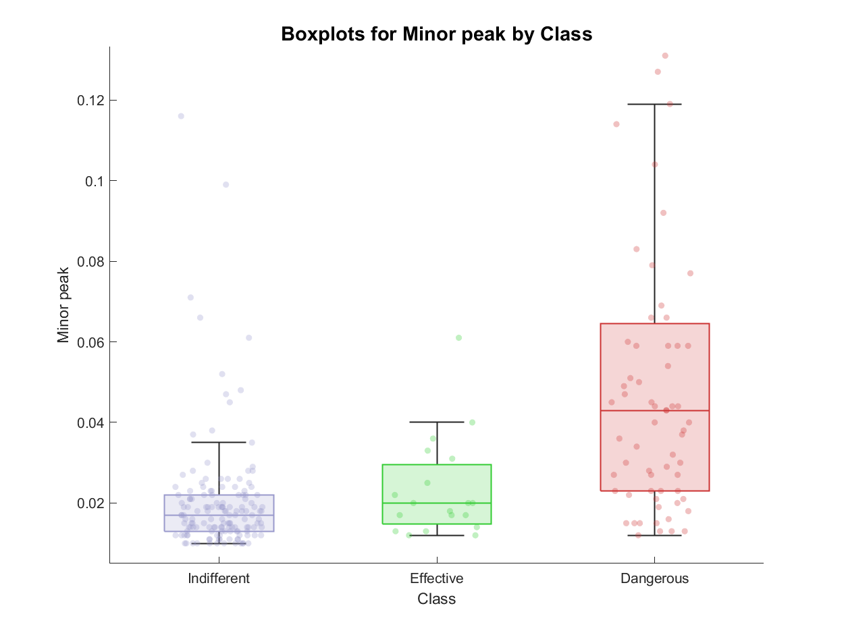
Envelope feature extraction: examples of features

Slide 5
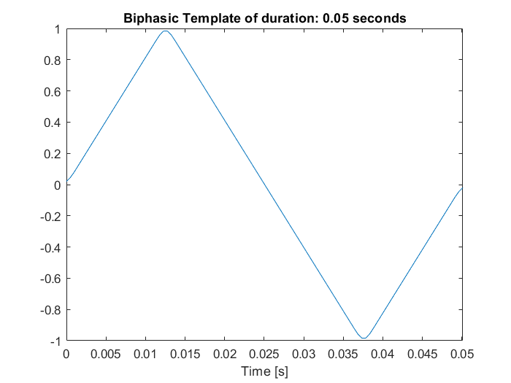
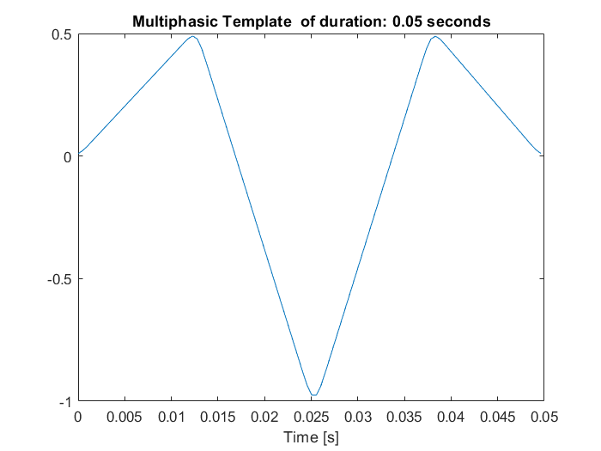
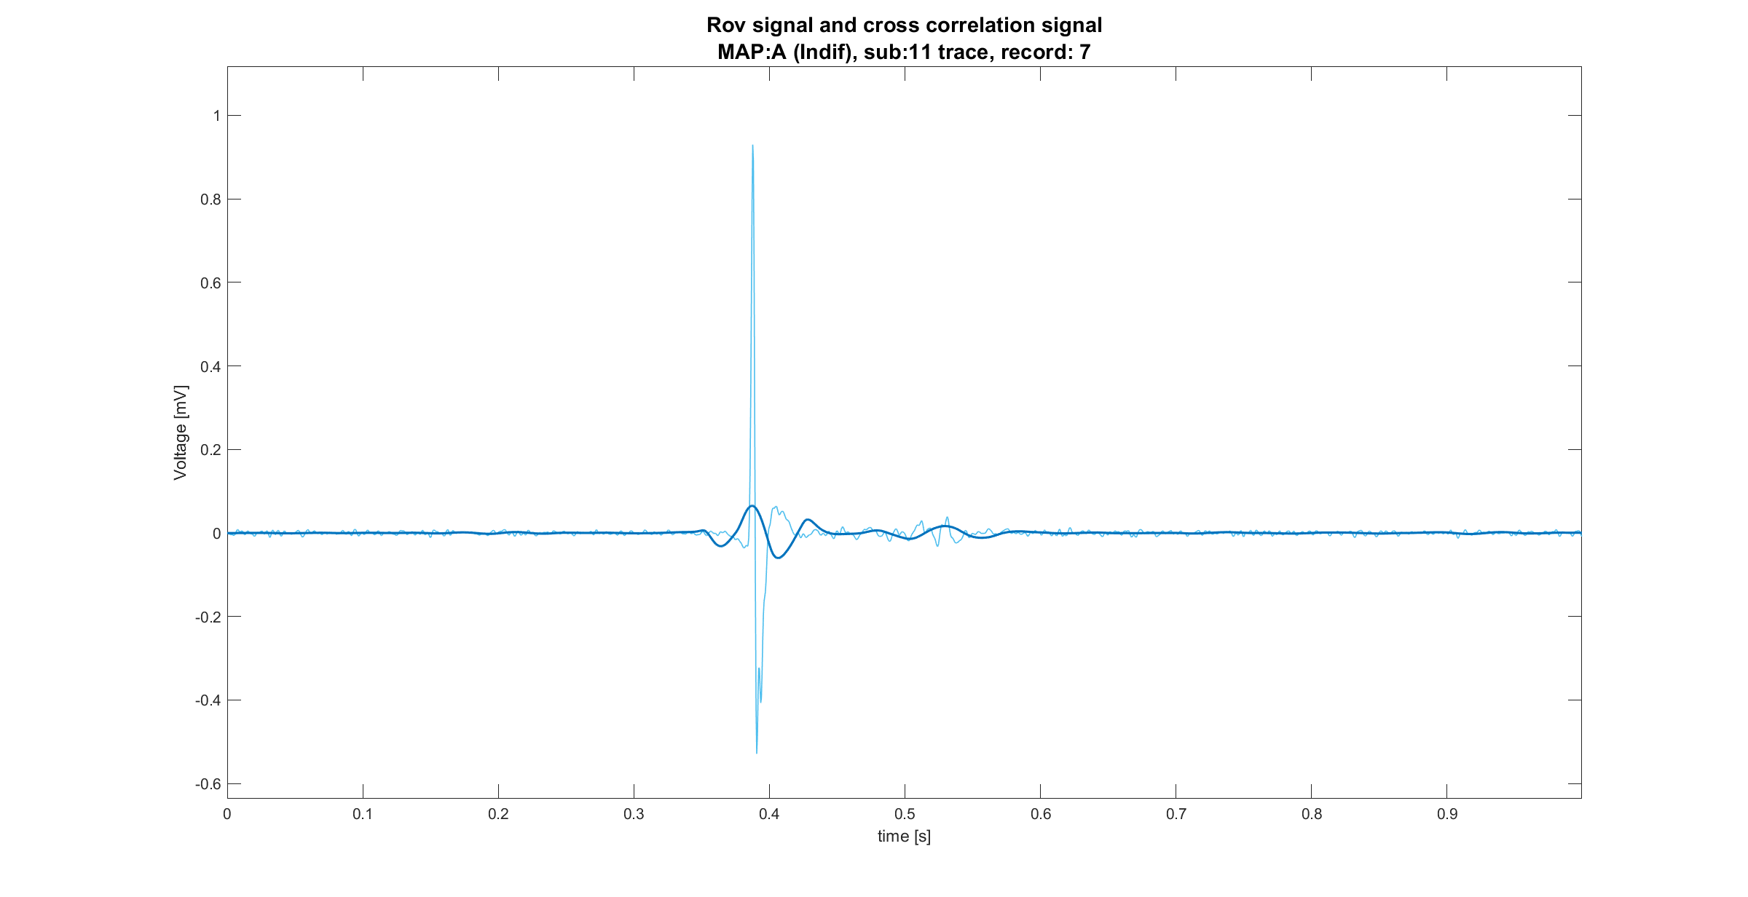
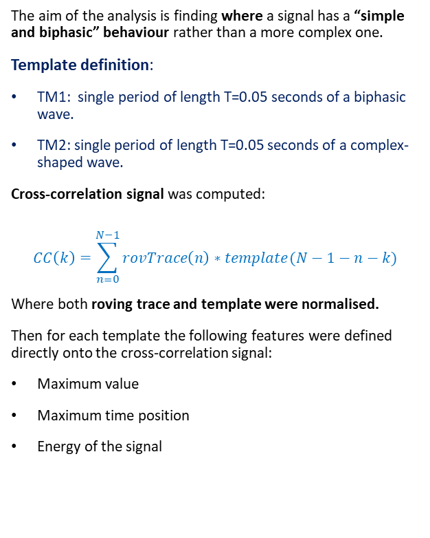
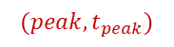
Template matching definition
The aim of the analysis is finding where a signal has a “simple and biphasic” behaviour rather than a more complex one.
Template definition:
TM1: single period of length T=0.05 seconds of a biphasic wave.
TM2: single period of length T=0.05 seconds of a complex-shaped wave.
Cross-correlation signal was computed:
$$CC\left(k\right)=\sum_{n=0}^{N−1}{rovTrace\left(n\right)∗template(N−1−n−k)}$$
Where both roving trace and template were normalised.
Then for each template the following features were defined directly onto the cross-correlation signal:
Maximum value
Maximum time position
Energy of the signal
$$(peak,t_{peak})$$

Slide 6
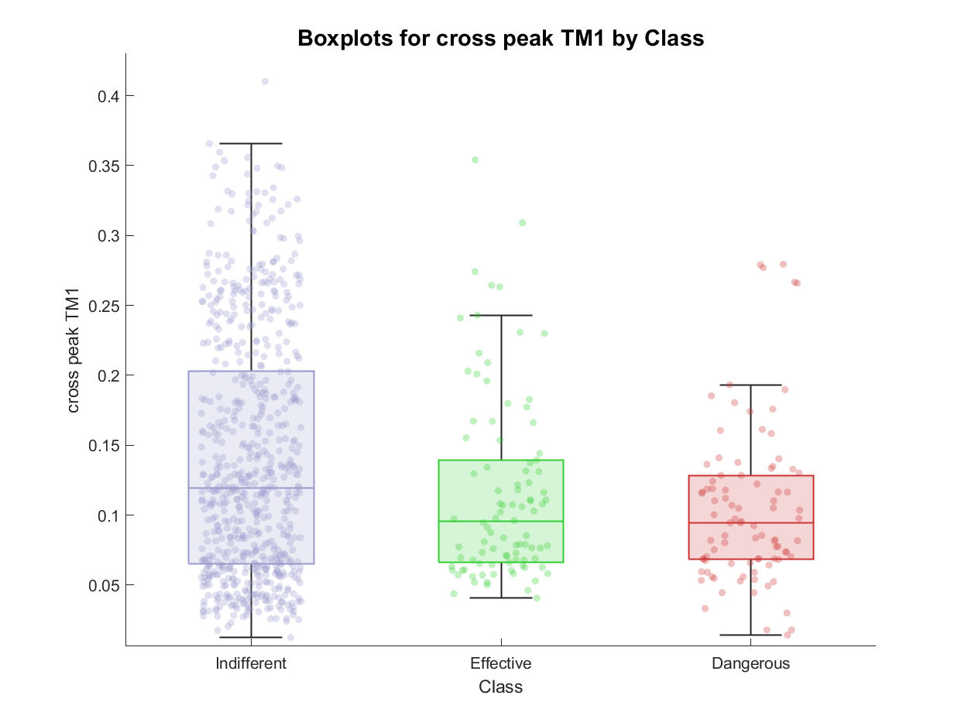
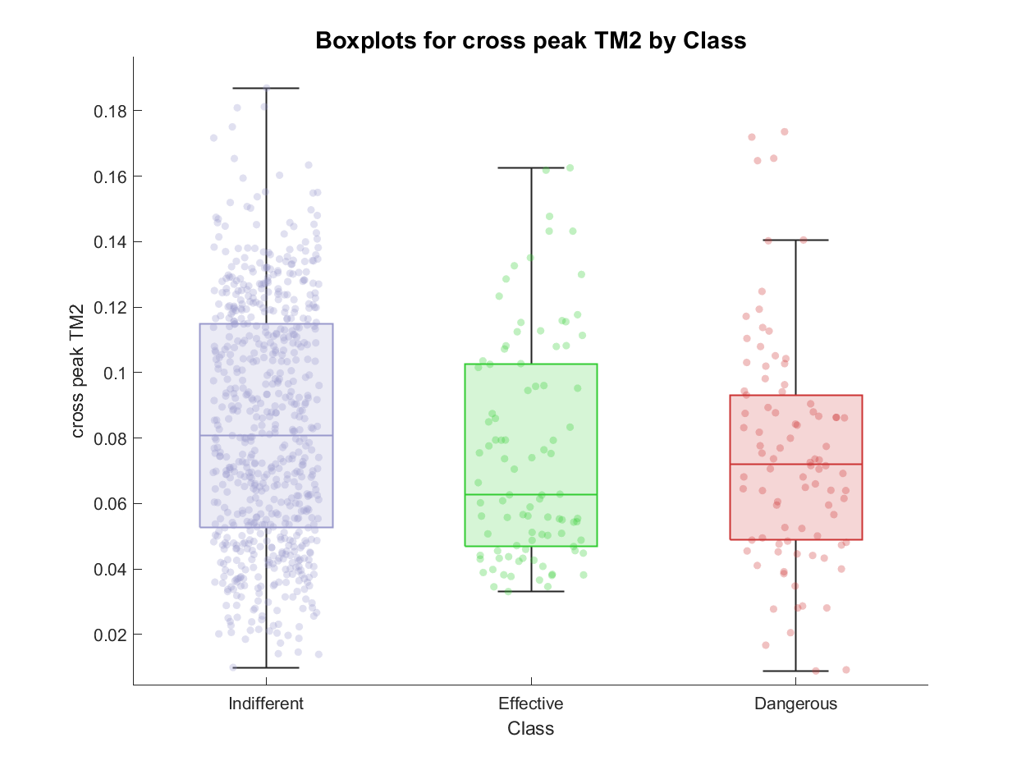
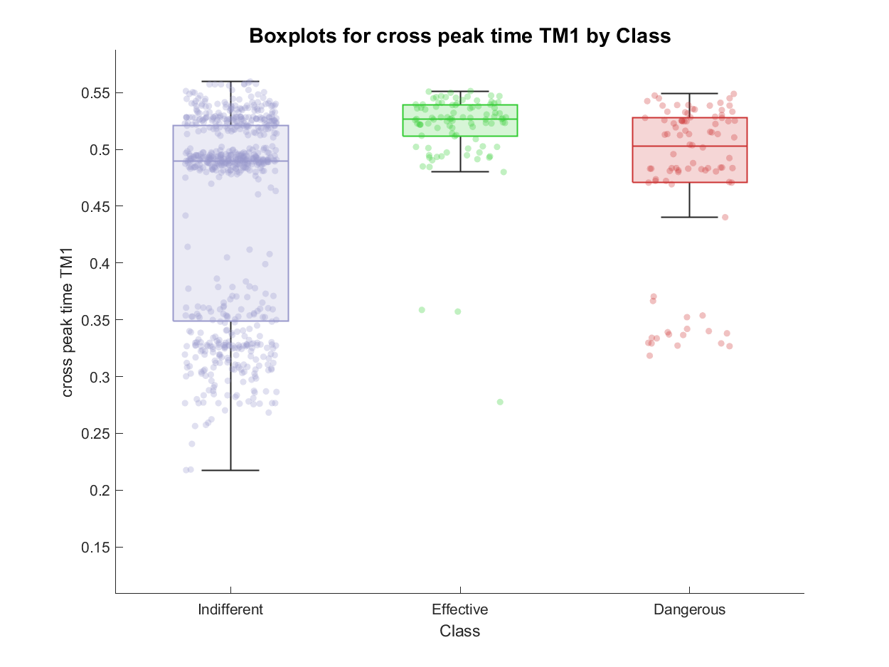
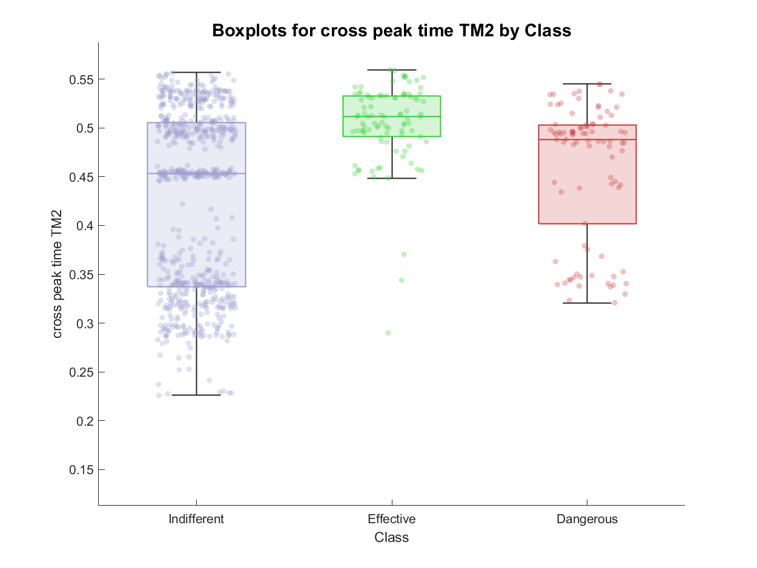
TM feature extraction: examples of features

Slide 7
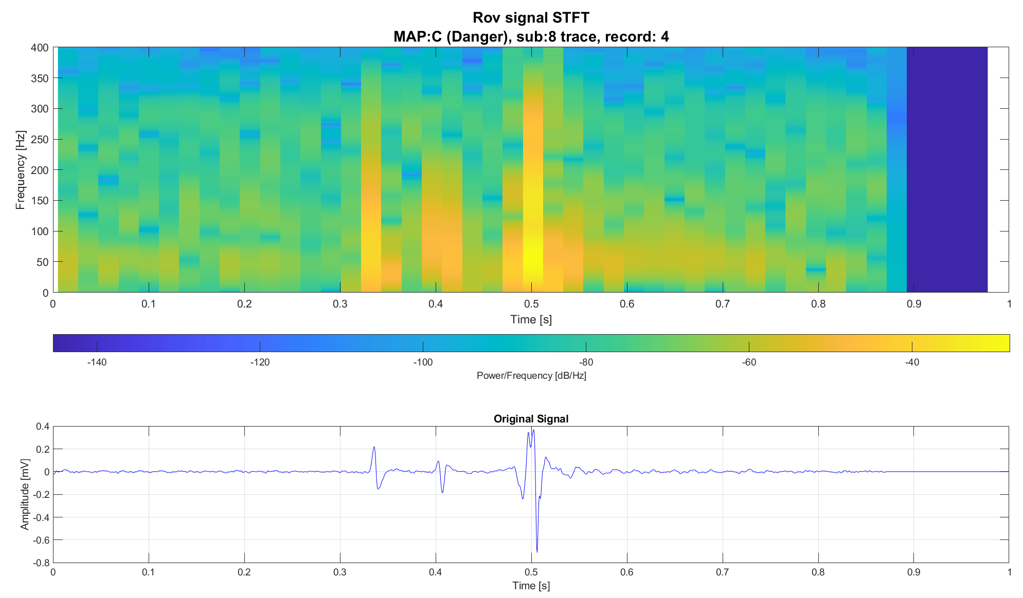
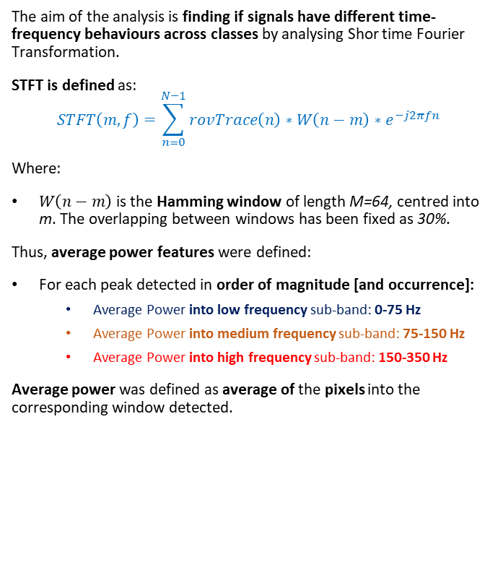
STFT definition
The aim of the analysis is finding if signals have different time-frequency behaviours across classes by analysing Shor time Fourier Transformation.
STFT is defined as:
$$STFT\left(m,f\right)=\sum_{n=0}^{N−1}{rovTrace\left(n\right)∗W\left(n−m\right)∗e^{−j2πfn} }$$
Where:
$W\left(n−m\right)$ is the Hamming window of length M=64, centred into m. The overlapping between windows has been fixed as 30%.
Thus, average power features were defined:
For each peak detected in order of magnitude [and occurrence]:
Average Power into low frequency sub-band: 0-75 Hz
Average Power into medium frequency sub-band: 75-150 Hz
Average Power into high frequency sub-band: 150-350 Hz
Average power was defined as average of the pixels into the corresponding window detected.
avg
avg
avg
avg
avg
avg
avg
avg
avg

Slide 8
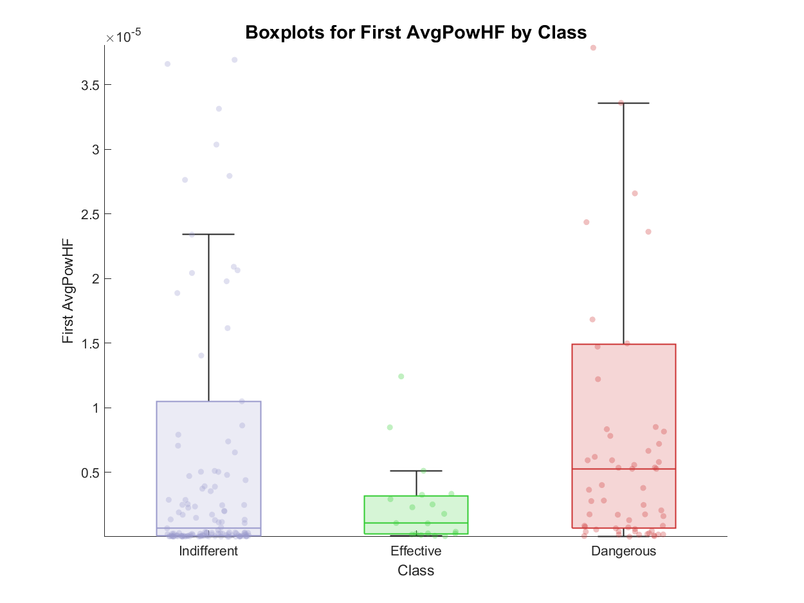
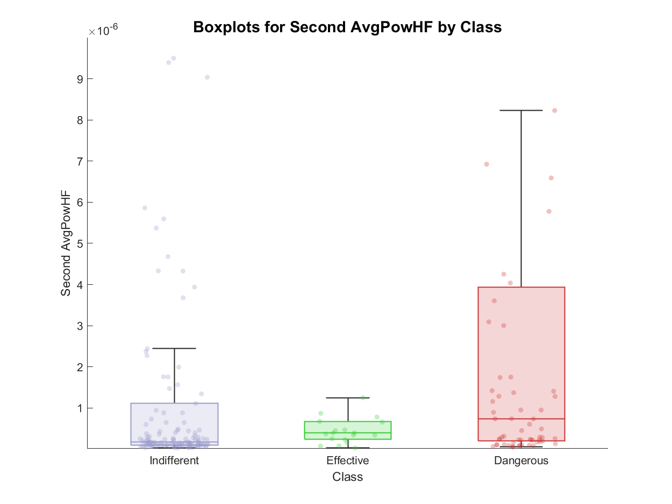
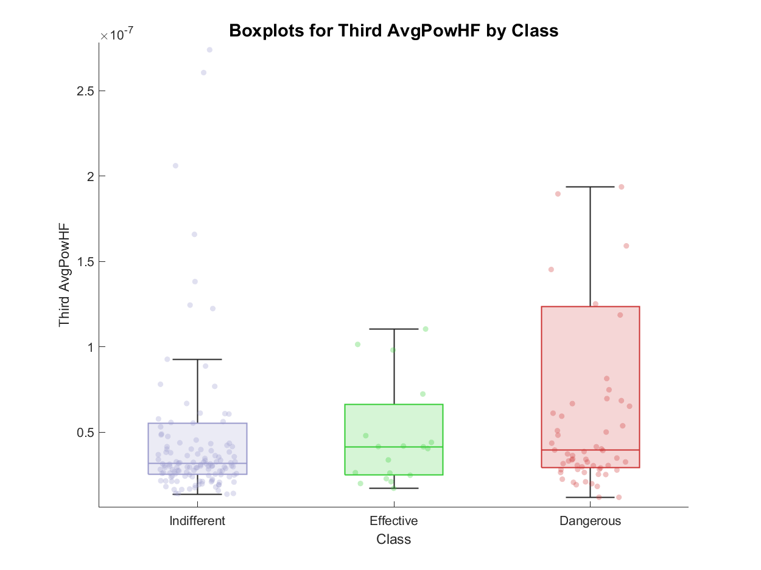
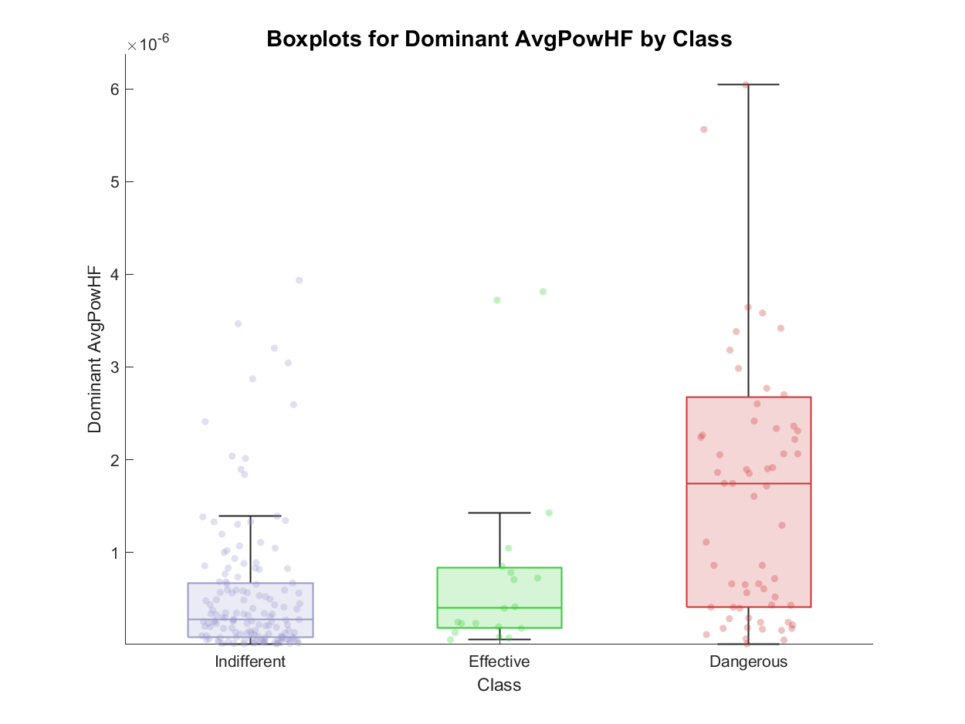
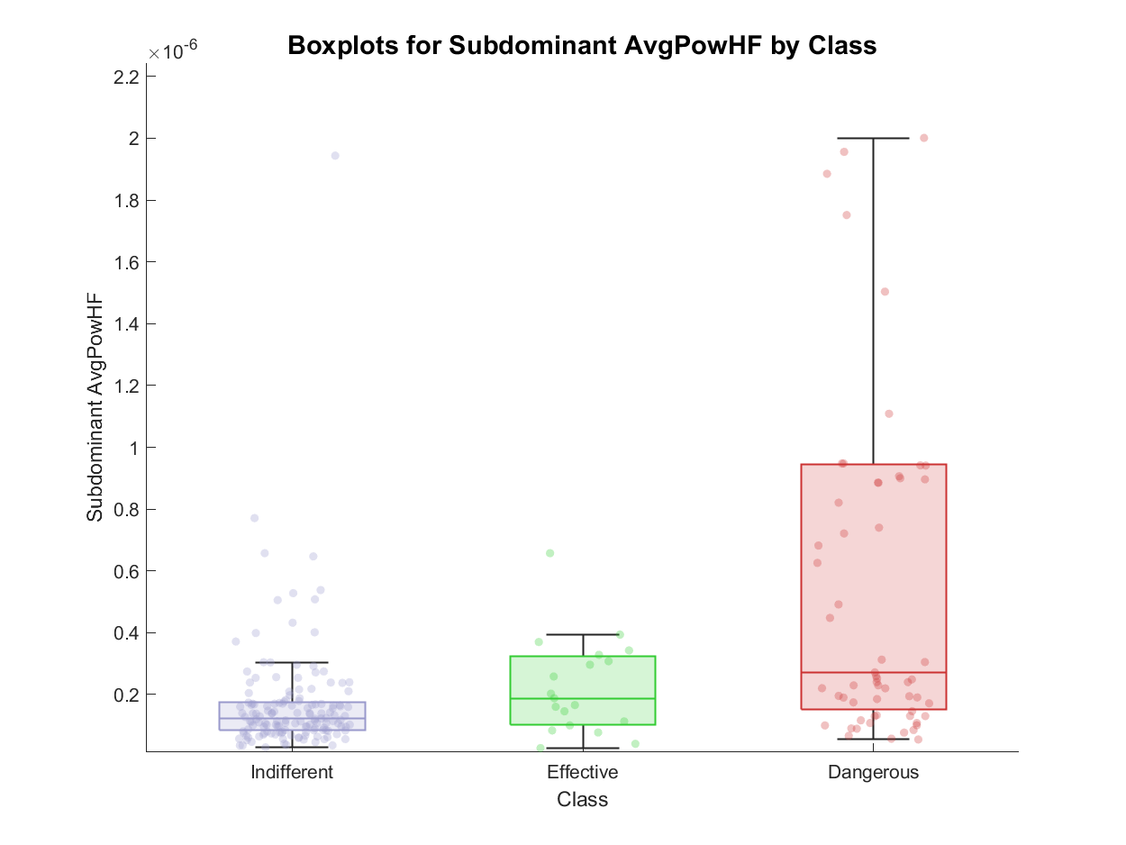
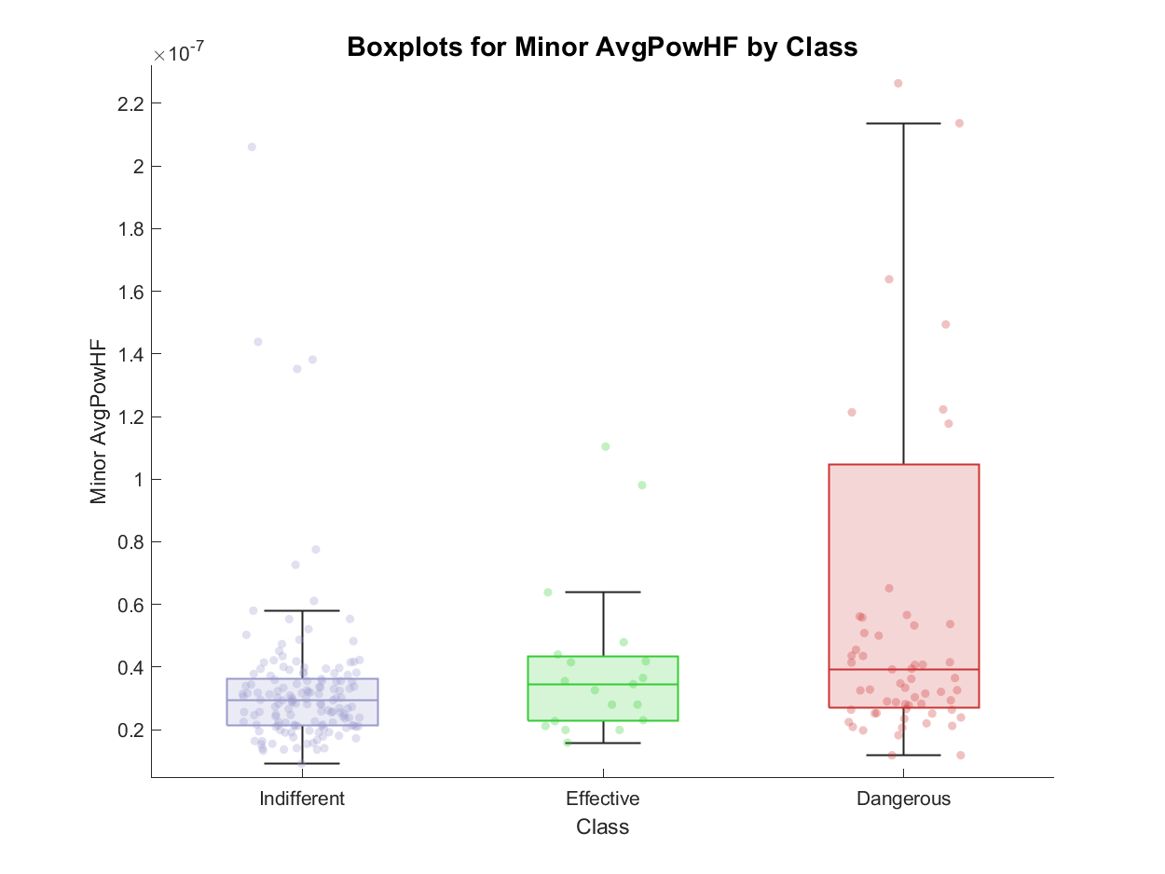
STFT feature extraction: examples of features

Slide 9
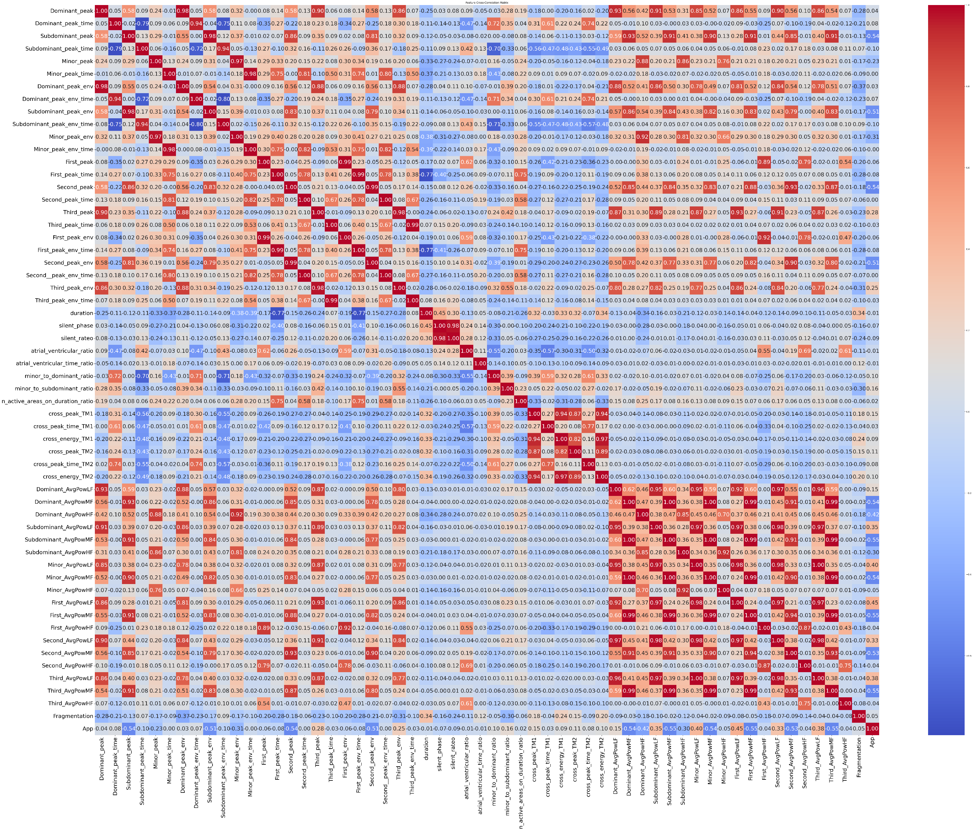
Feature correlation analysis
To avoid the usage of features correlated between each other, correlation matrix has been computed and some of:
Envelope features
Template Matching features
STFT features
Were excluded from the analysis
From an initial number of 59 features, a dataset of 31 features was obtained.

Slide 10
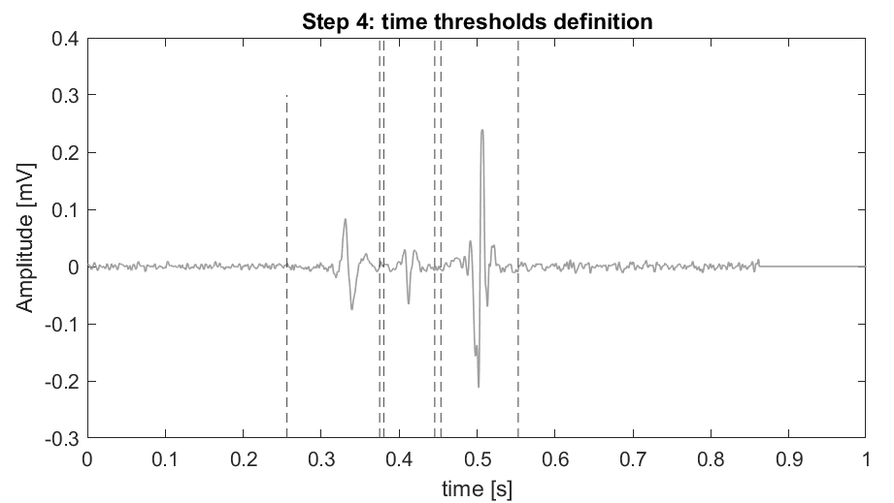
Knowledge based classifier
Four knowledge-based classifiers were defined, and the best one is reported.
Aim: assess if a KB classifier can meet the problem
Feature extraction
Is Minor_peak >0.021?
No
Is Dominant_peak_time <0.49
No
Effective
Yes
Yes
Dangerous
Indifferent

Slide 11
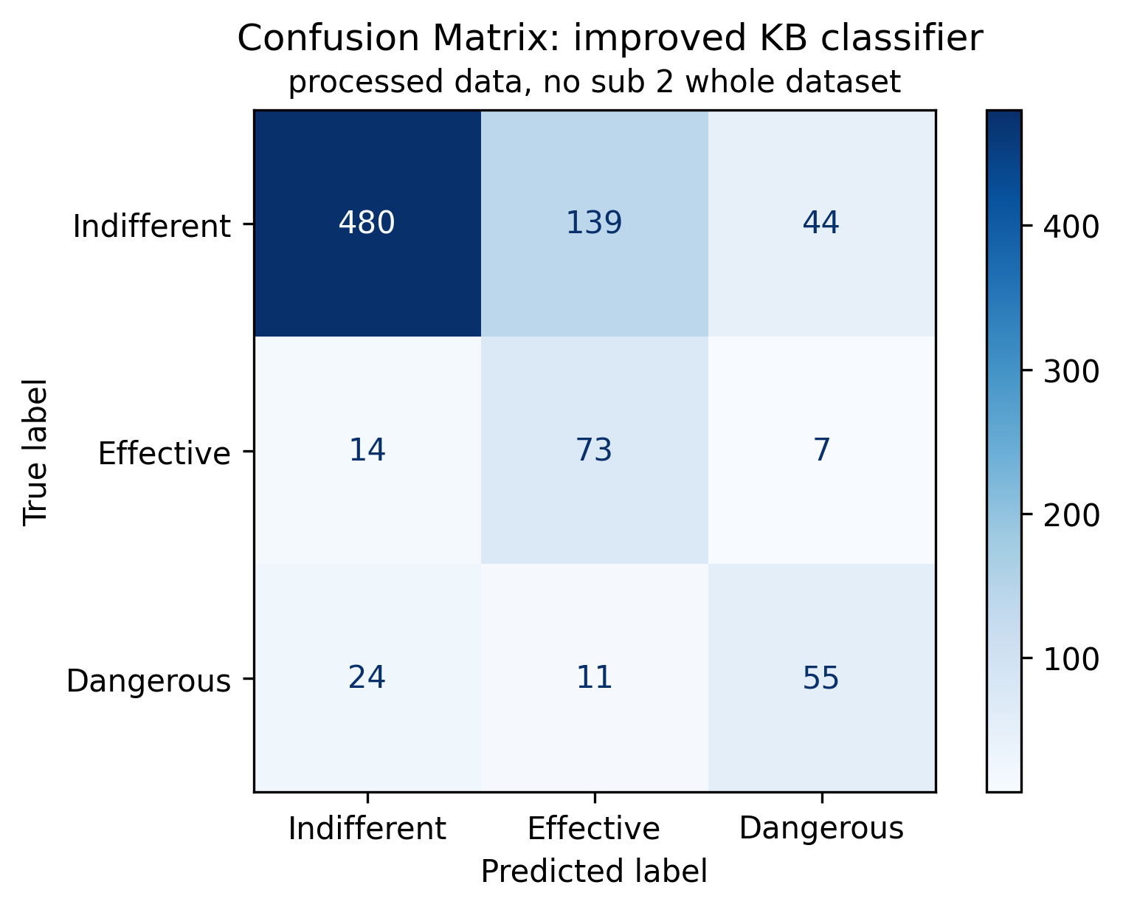
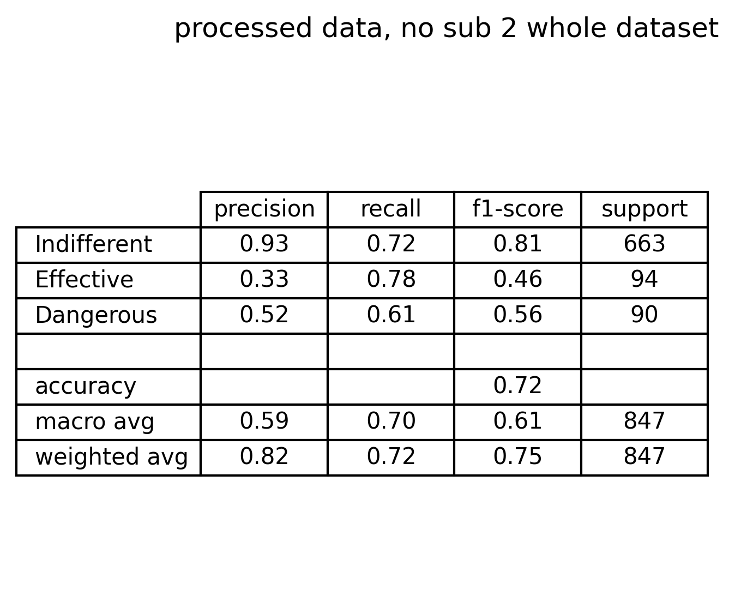
Knowledge based classifier performance
Confusion matrix comments:
Indifferent signals have good performance
Effective signals suffer of bad precision but sufficient recall
Dangerous signals suffer of both low precision and recall
There are 44 indifferent signals recognized as dangerous (acceptable scenario)
There are 24 dangerous signals classified as indifferent (risky scenario)
There are 11 dangerous signals classified as effective (very critical scenario)
Knowledge based classifier suffers of too many criticises

Slide 12
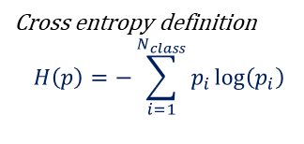
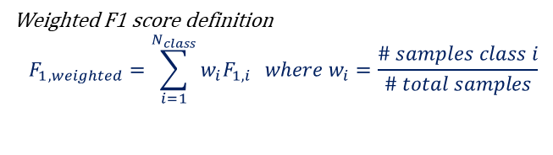
Machine learning approaches
SLIDE RIASSUNTIVA CON LE TRE METODOLOGIE
Tree classifiers
Tree 1: whole feature set
Tree 2: relevant feature set
Impurity measure: Cross entropy
Impurity measure: Cross entropy
Depth: maximising weighted f1 score
Depth: maximising weighted f1 score
Cross entropy definition
$$H\left(p\right)=−\sum_{i=1}^{N_{class}}{p_{i}\log\left(p_{i}\right)}$$
Weighted F1 score definition
$$F_{1, weighted}=\sum_{i=1}^{N_{class}}{w_{i}F_{1,i} } where w_{i}=\frac{\# samples class i}{\# total samples}$$

Slide 13
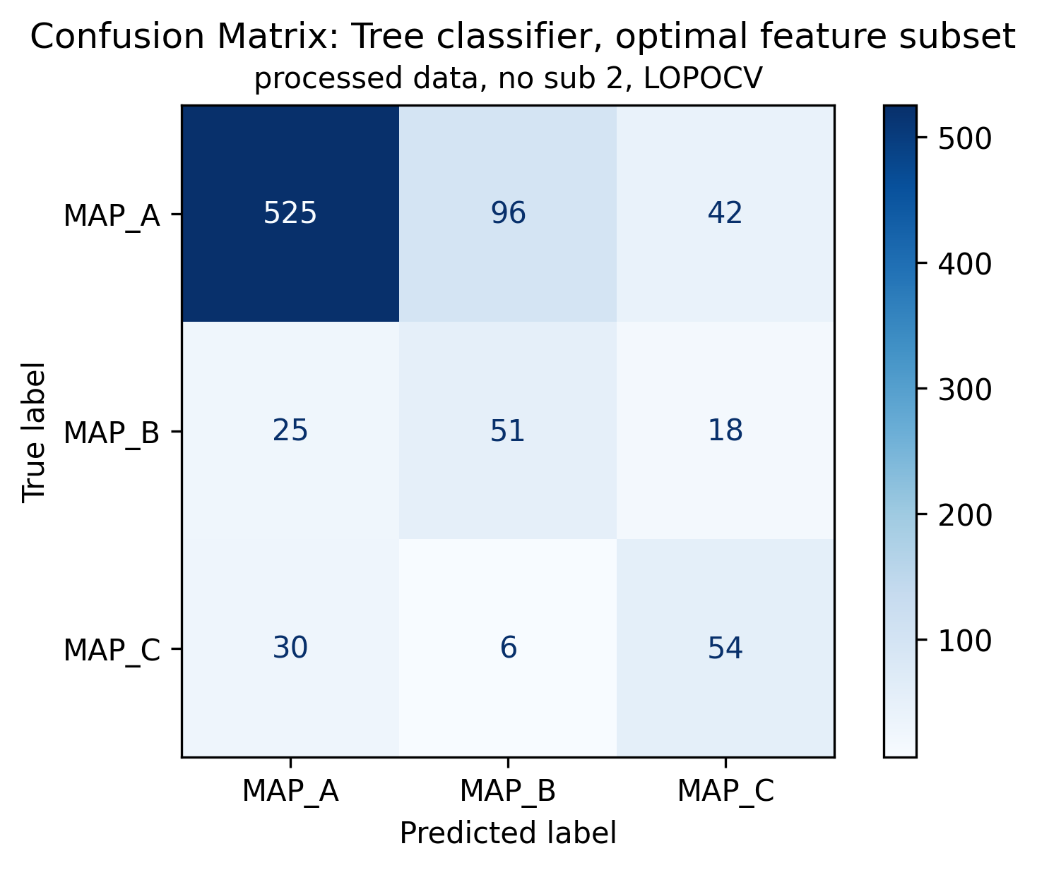
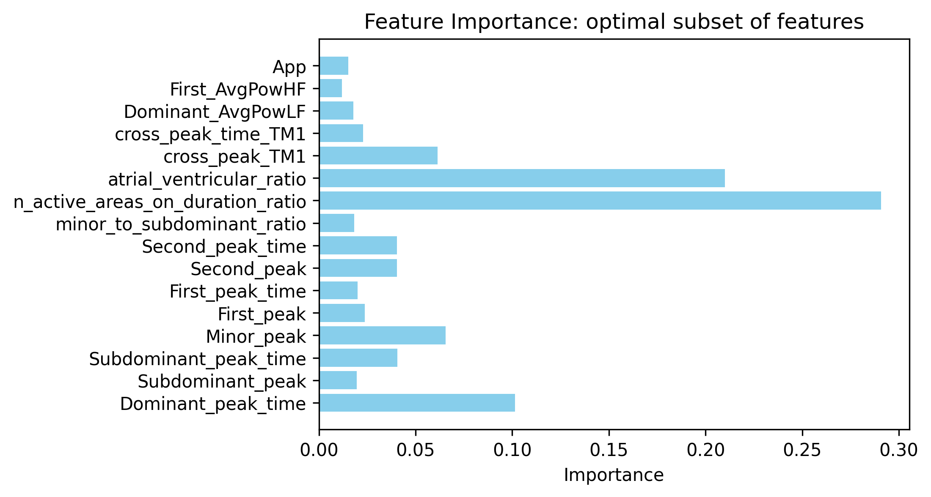
Tree classifier V2 – subset of features: results
Tree 2: relevant features set
Of 847 signals:
663 are ineffective (MAP A, 78.28%);
94 are effective (MAP B, 11.1%);
90 are dangerous (MAP C, 10.63%);

Slide 14
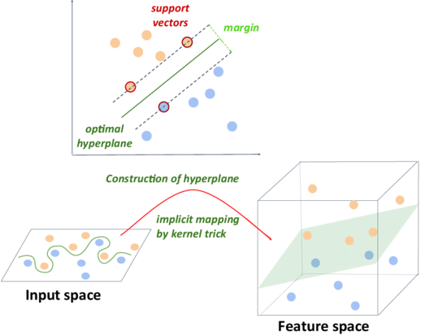
Machine learning approach: Support Vector Machines
Support Vector Machines (SVMs) are a powerful supervised learning method used for classification and regression tasks.
The key principle of SVMs is margin maximization: they aim to identify the hyperplane that has the largest margin (distance) to the nearest data points of any class, known as support vectors.
For complex datasets that are not linearly separable, SVMs employ the kernel trick, which maps the input features into a higher-dimensional space where linear separation is possible. Common kernels include linear, polynomial, and Gaussian.
These three kernels were compared in terms of performance, and the best one was used for model reduction.

Slide 15
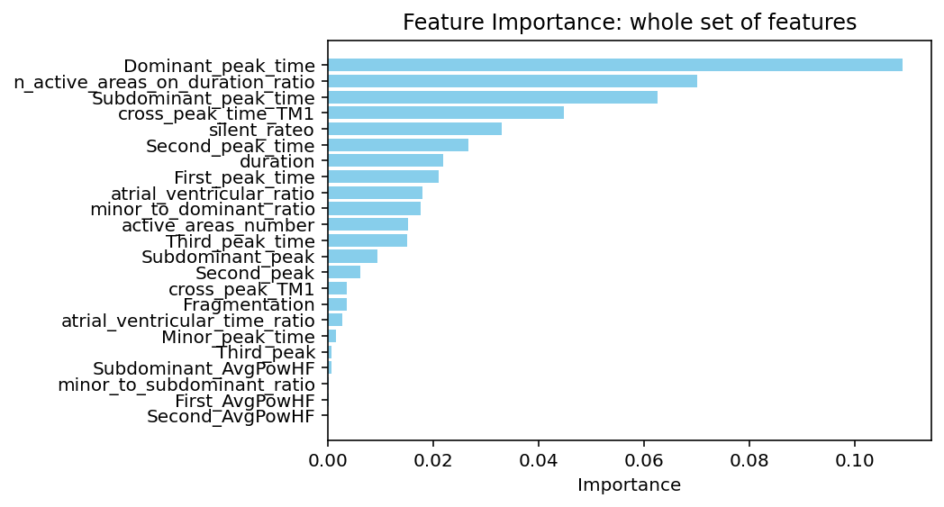
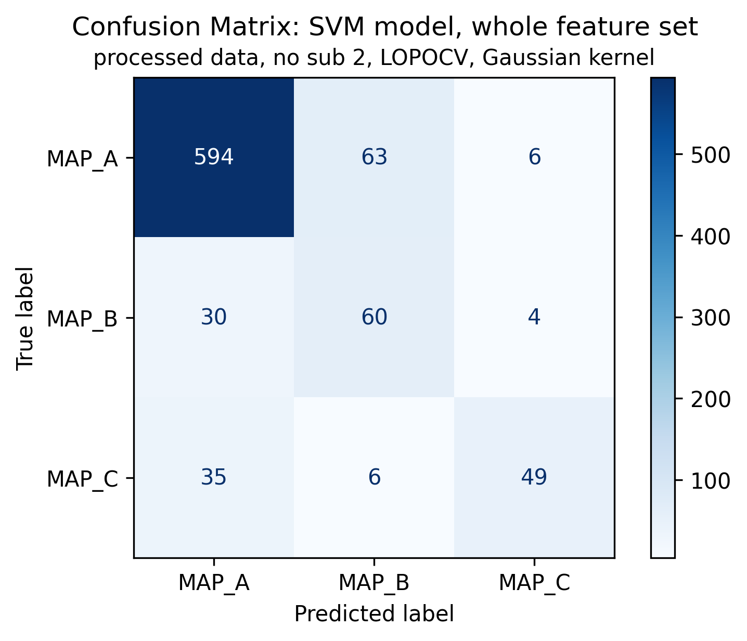
SVM classifiers: Gaussian kernel feature importance
SVM1: Gaussian Kernel
Of 847 signals:
663 are ineffective (MAP A, 78.28%);
94 are effective (MAP B, 11.1%);
90 are dangerous (MAP C, 10.63%);

Slide 16

SVM classifiers: LOPOCV confusion matrix comparison
SVM 1: whole feature set
SVM 2: relevant feature subset
SVM 2: relevant feature subset
Of 847 signals:
663 are ineffective (MAP A, 78.28%);
94 are effective (MAP B, 11.1%);
90 are dangerous (MAP C, 10.63%);

Slide 17
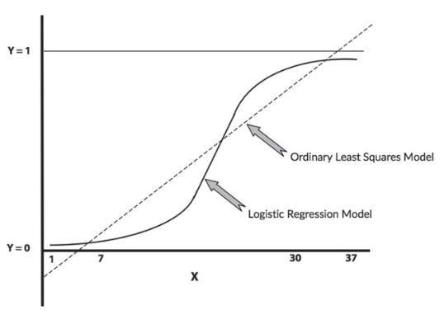
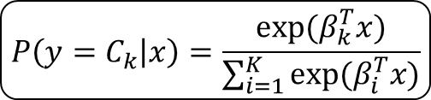
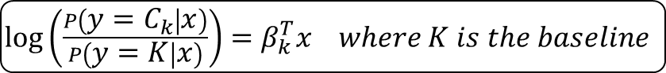
Machine learning approach: Multinomial logistic regression
Multinomial Logistic Regression (MLR) is a widely-used supervised learning method for multi-class classification problems.
The core concept of MLR is to model the probabilities of each class as a function of the input features using a softmax function, ensuring that the predicted probabilities sum to one.
Unlike binary logistic regression, MLR generalizes to handle more than two categories by estimating a separate set of coefficients for each class relative to a baseline.
MLR assumes a linear relationship between the input features and the log odds of the class probabilities, making it effective for linearly separable datasets.
$$P\left(y=C_{k} | x\right)=\frac{exp⁡(β_{k}^{T}x)}{\sum_{i=1}^{K}{exp⁡(β_{i}^{T}x)}}$$
$\log\left(\frac{P\left(y=C_{k} | x\right)}{P\left(y=K | x\right)}\right)=β_{k}^{T}x where K is the baseline$

Slide 18

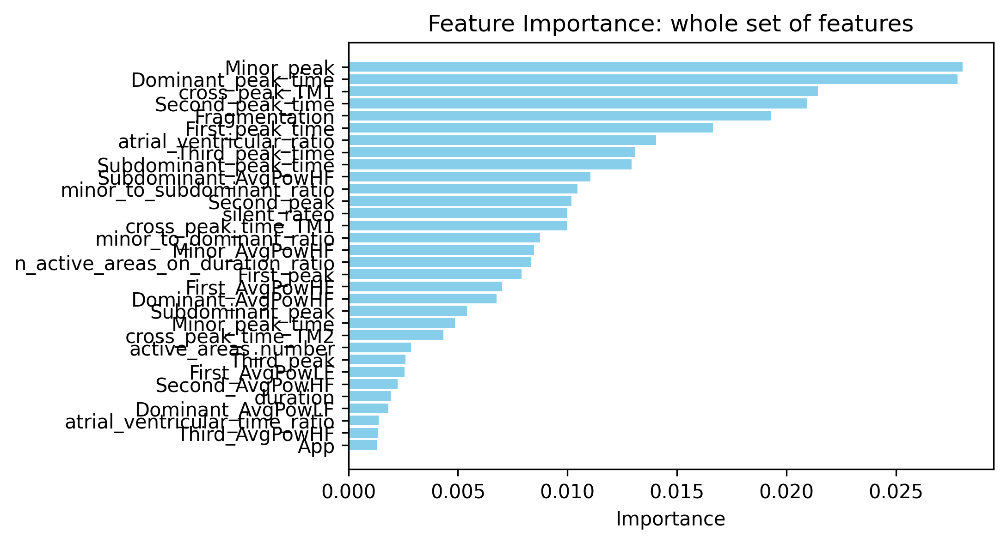
GLM classifier V1 - whole feature set: results
MLR 1: whole feature set
Of 847 signals:
663 are ineffective (MAP A, 78.28%);
94 are effective (MAP B, 11.1%);
90 are dangerous (MAP C, 10.63%);

Slide 19
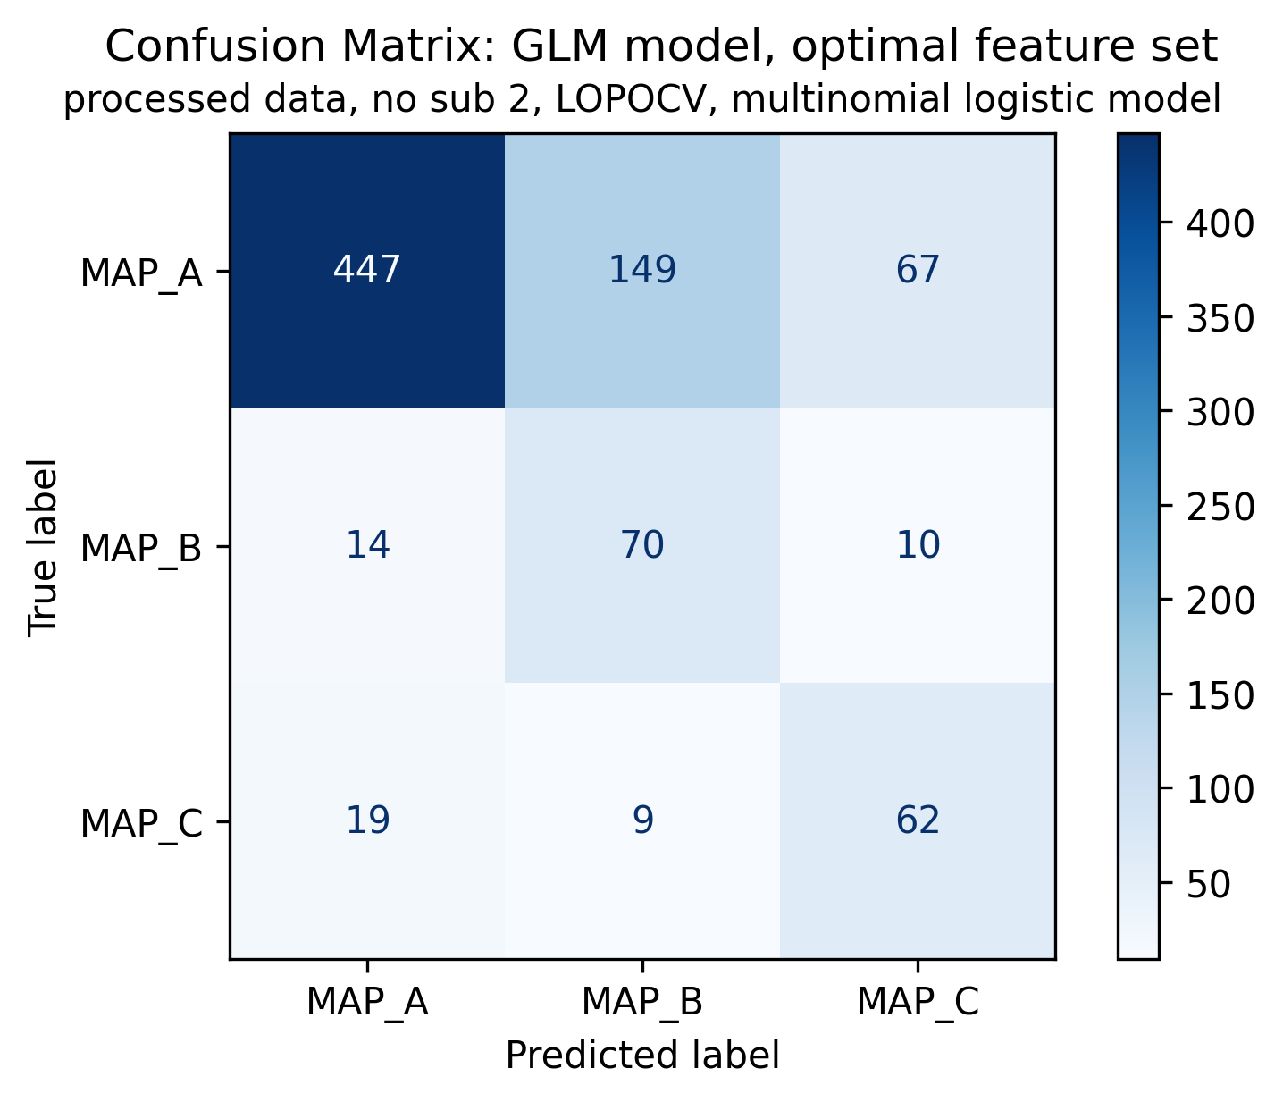
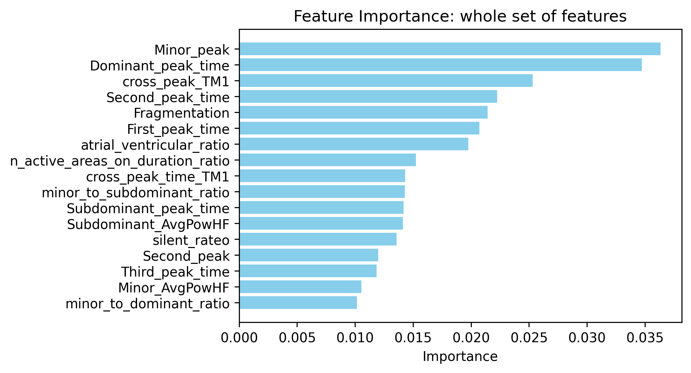
GLM classifier V2 – subset of features: results
MLR 2: relevant features set
Of 847 signals:
663 are ineffective (MAP A, 78.28%);
94 are effective (MAP B, 11.1%);
90 are dangerous (MAP C, 10.63%);

Slide 20
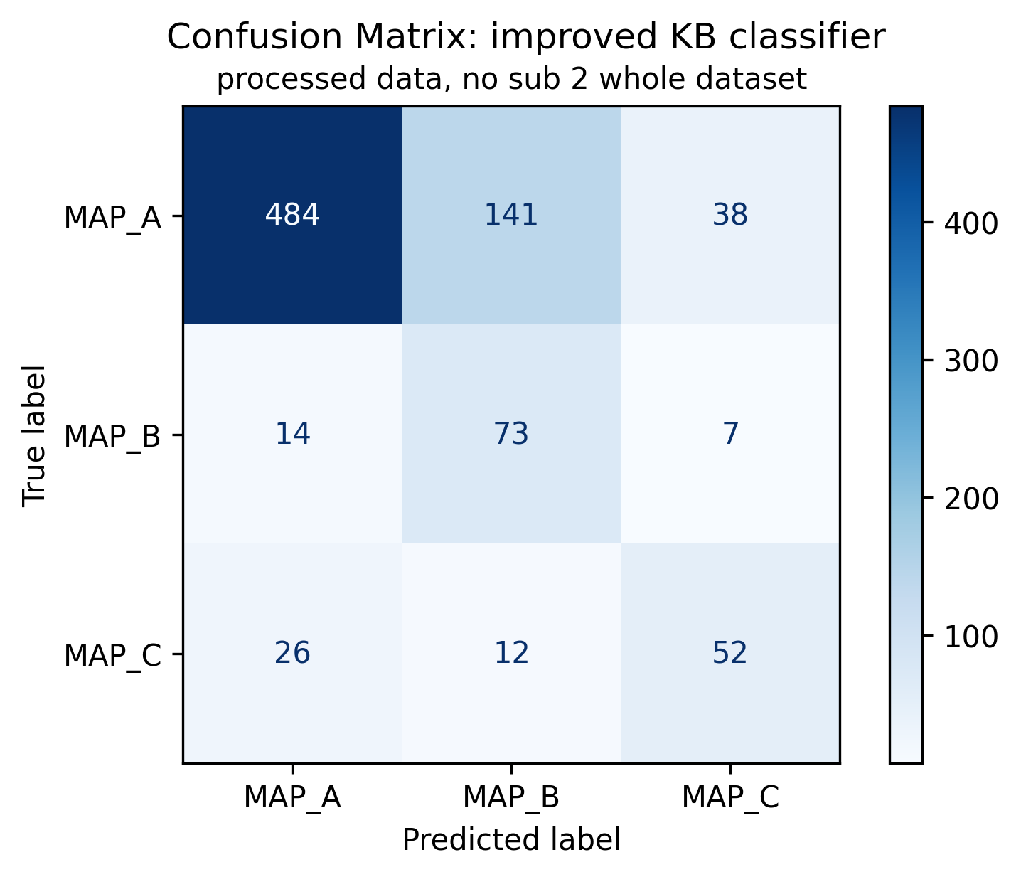
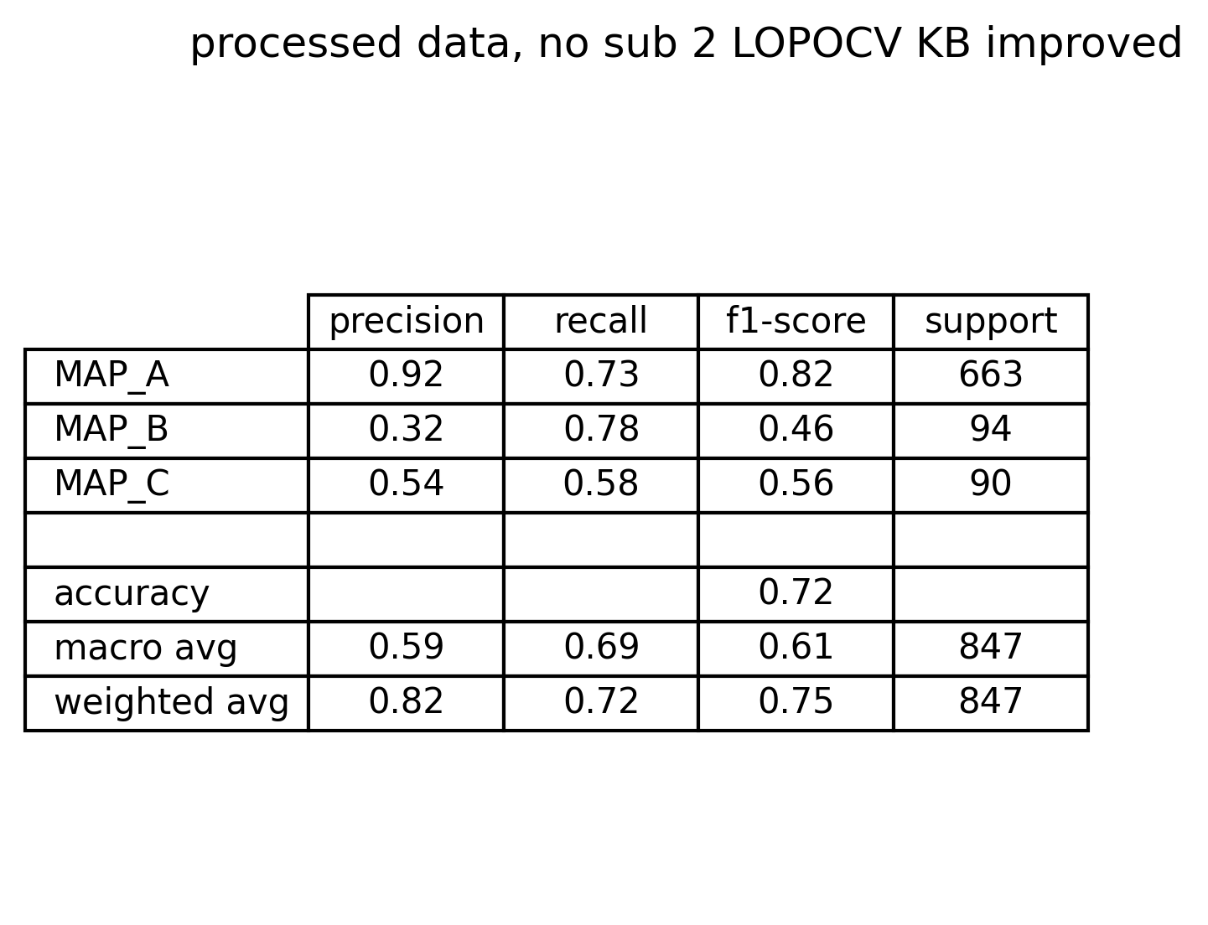
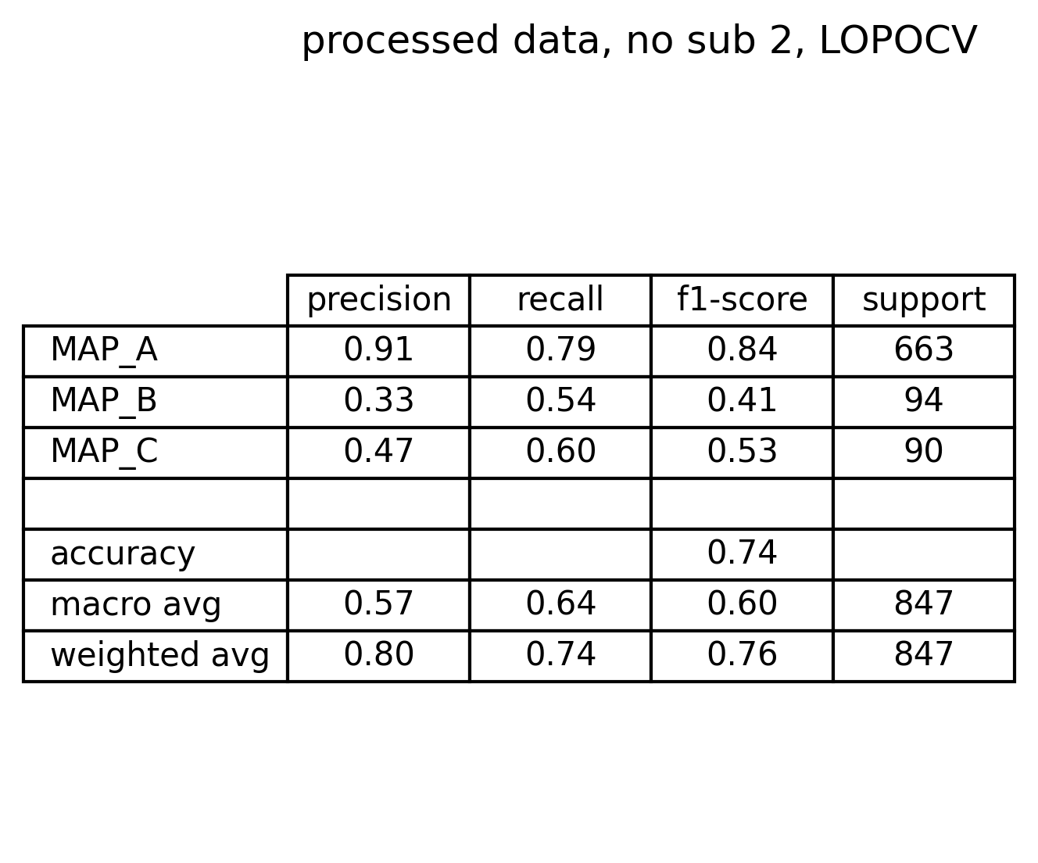
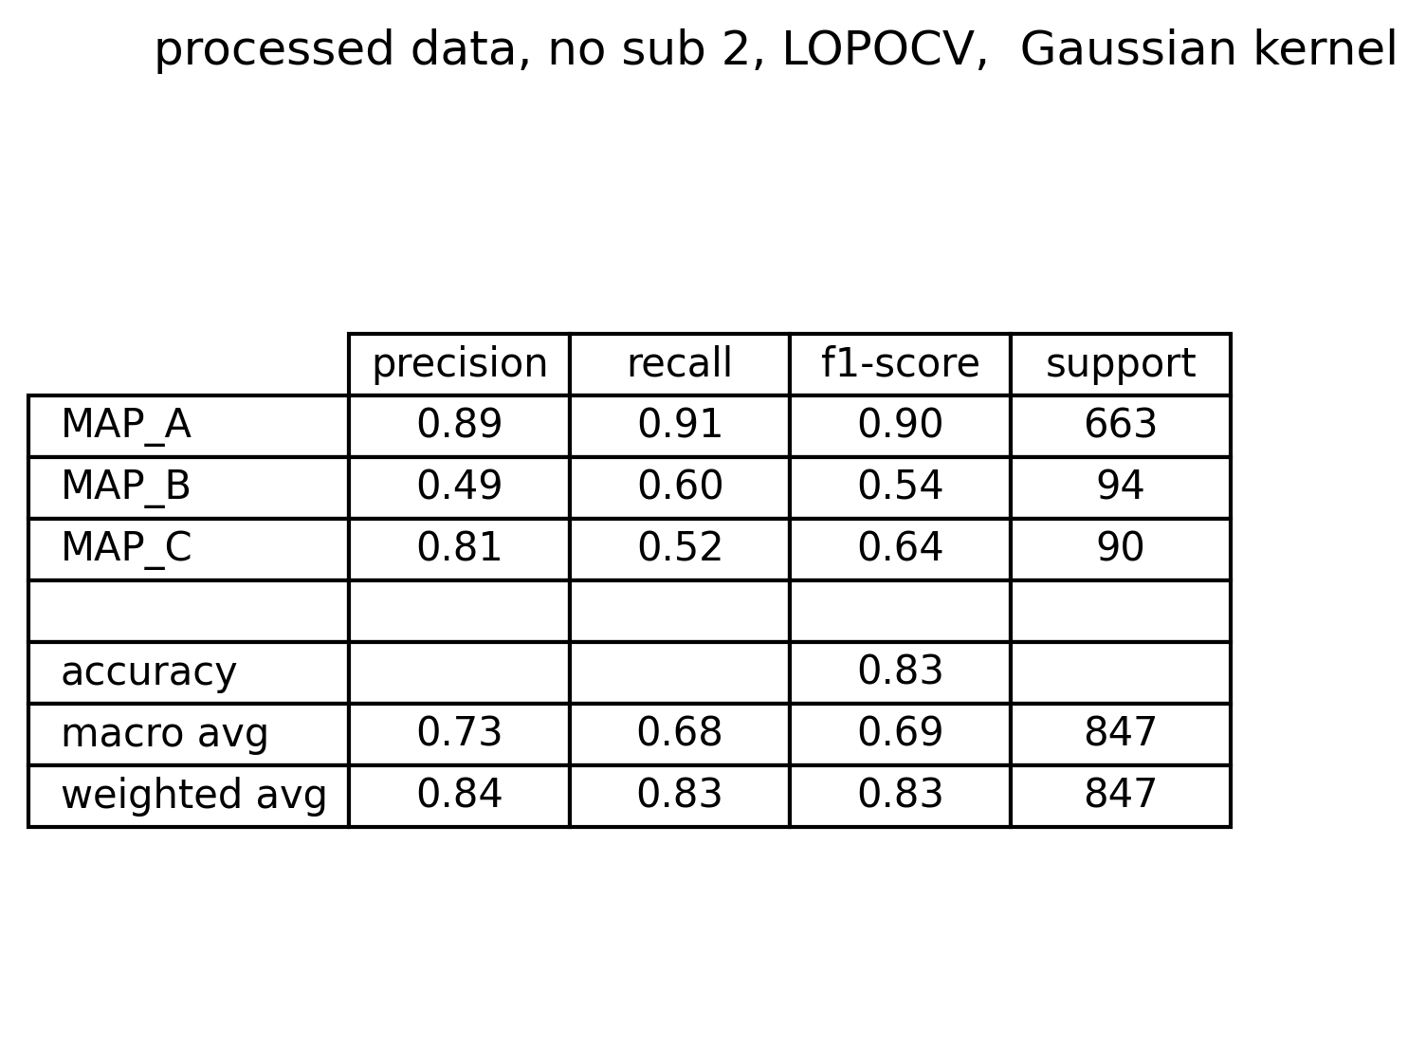
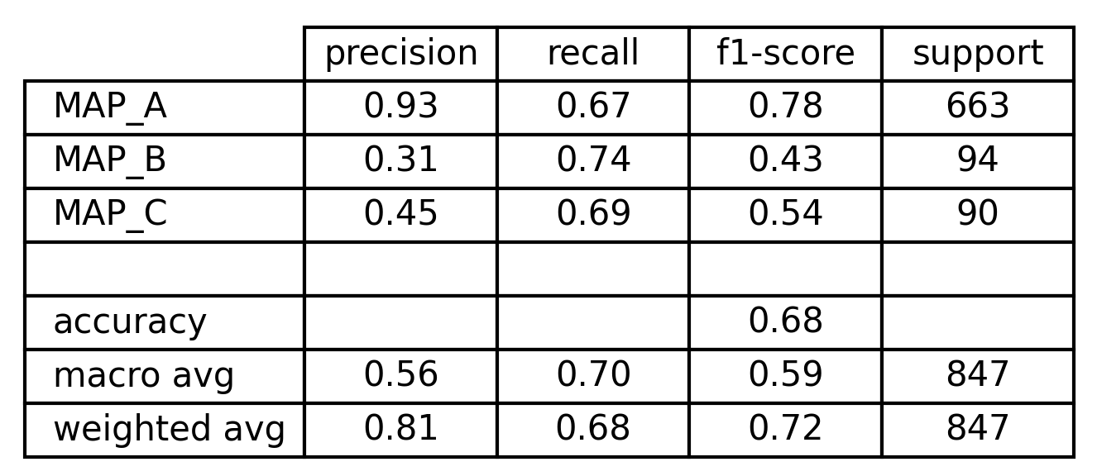
Best models comparison
KB V2: peaks thresholds and position
Tree 2: relevant feature subset
SVM 2: relevant feature subset
MLR 2: relevant feature subset

Slide 21
Take home messages
MLR 2: relevant feature subset
SVM 2: relevant feature subset
Take home messages:
GLM is the best classifier for effective signals (MAP B) and dangerous signals (MAP C), but:
higher misclassification of ineffective signals into effective ones
Higher misclassification of dangerous signals into ineffective (MAP A) ones
SVM reaches the highest weighted f1-score overall, comparing with the ne obtained from other similar studies (Baldazzi et al, 2023)

Slide 22
Conclusions
Three feature extraction pipelines based on envelope analysis, template matching and STFT have proposed:
Envelope features provides information on active areas of the signal
Template matching features provides information on signal morphology
STFT features provides information on average power across different frequency intervals and between active areas
Then, a total of 9 models have been evaluated:
An improved Knowledge based model based on envelope features
A decision tree (Leave One Patient Out Cross Validation) trained onto the whole feature set
A decision tree (LOPOCV) trained onto an optimized feature set
3 SVM models with different kernel (LOPOCV) definition onto the whole feature set
A gaussian kernel SVM (LOPOCV) onto an optimized feature set
Multinomial logistic regression (LOPOCV) trained onto the whole feature set
Multinomial logistic regression (LOPOCV) trained onto an optimized feature set
Results are encouraging, MLR model reaches the highest precision for MAP B and MAP C but has overall performances similar to the knowledge-based classifier . Gaussian kernel SVM model, defined onto a reduced set of feature, has the best overall performance, reaching a weighted f1-score of 0.82.
It has been shown that envelope-based features are the most relevant ones, confirmed by both the feature importance analysis and SHAP plots. Secondly, even Template matching features and STFT based ones plays a certain role into cases classification, with the TM ones more relevant then STFT ones, which are discharged by SVM models.

